Slide 1
Chapter 3: Single-stage Amplifiers
3.1 Applications
3.2 General Considerations
3.3 Common-Source Stage
3.4 Source Follower
3.5 Common-Gate Stage
3.6 Cascode Stage

Slide 2
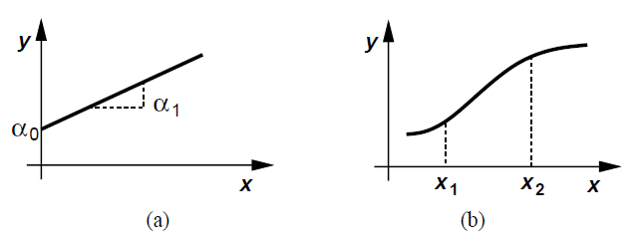

Ideal vs Non-ideal Amplifier
Ideal amplifier (Fig. a)
  Large-signal characteristic is a straight line
  α₁ is the “gain”, α₀ is the “dc bias”
Nonlinear amplifier (Fig. b)
  Large signal excursions around bias point
  Varying “gain”, approximated by polynomial
  Causes distortion of signal of interest

Slide 3
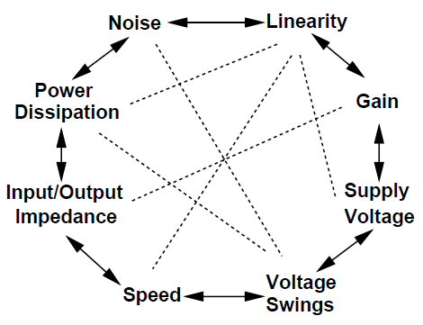
Analog Design Tradeoff
Along with gain and speed, other parameters also important for amplifiers
Input and output impedances decide interaction with preceding and subsequent stages
Performance parameters trade with each other
  Multi-dimensional optimization problem

Slide 4
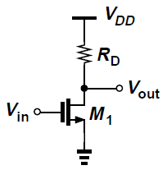

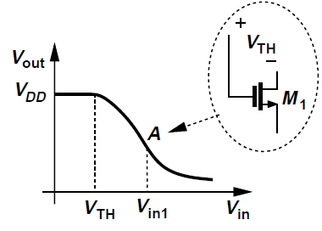

Common-Source stage with Resistive load
Very high input impedance at low frequencies
For V_{in} < V_{TH}, M₁ is off and V_{out} = V_{DD}
When V_{in} > V_{TH}, M₁ turns on in saturation region, V_{out} falls
When V_{in} > V_{in1}, M₁ enters triode region
At point A, V_{out} = V_{in1}-V_{TH}

Slide 5

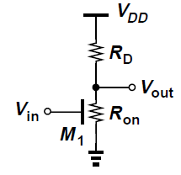
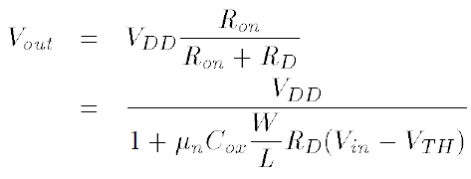
Common-Source stage with Resistive load
For V_{in} > V_{in1,}
If V_{in} is high enough to drive M₁ into deep triode region so that V_{out} << 2(V_{in} - V_{TH}),

Slide 6
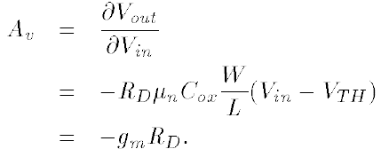
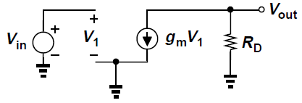


Common-Source stage with Resistive load
Taking derivative of I_{D} equation in saturation region, small-signal gain is obtained
Same result is obtained from small-signal equivalent circuit
g_{m} and A_{v} vary for large input signal swings according to
This causes non-linearity

Slide 7


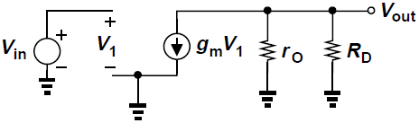



Common-Source stage with Resistive load
For large values of R_{D}, channel-length modulation of M₁ becomes significant, V_{out} equation becomes
Voltage gain is
Above result is also obtained from small-signal equivalent circuit

Slide 8
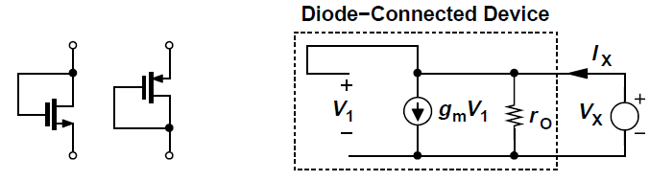



Diode-Connected MOSFET
A MOSFET can operate as a small-signal resistor if its gate and drain are shorted, called a “diode-connected” device
Transistor always operates in saturation
Impedance of the device can be found from small-signal equivalent model

Slide 9
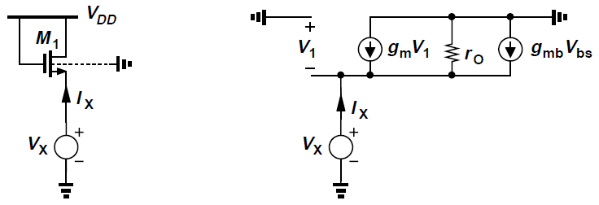


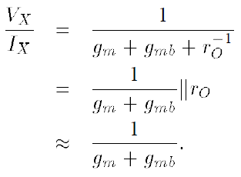

Diode-Connected MOSFET
Including body-effect, impedance “looking into” the source terminal of diode-connected device is found as

Slide 10
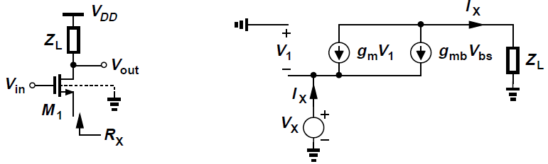




Diode-Connected MOSFET: Example
Find R_{X} if λ = 0
Set independent sources to zero, apply V_{X} and find resulting I_{X}
Result is same compared to when drain of M₁ is at ac ground, but only when λ = 0
Loosely said that looking into source of MOSFET, we see 1/g_{m} when λ = γ = 0

Slide 11
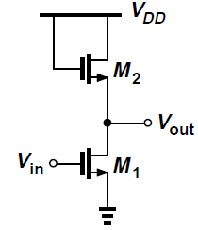
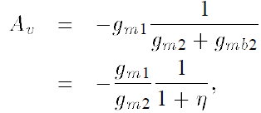


CS Stage with Diode-Connected Load
Neglecting channel-length modulation, using impedance result for diode-connected device,
where,
Expressing g_{m1} and g_{m2} in terms of device dimensions,
This shows that gain is a weak function of bias currents and voltages, i.e., relatively linear input-output characteristic

Slide 12


CS Stage with Diode-Connected Load
From large-signal analysis,
If V_{TH2} does not vary much with V_{out}, input-output characteristic is relatively linear.
Squaring function of M₁ (from its input voltage to its drain current) and square root function of M₂ (from its drain current to its overdrive) act as inverse functions

Slide 13
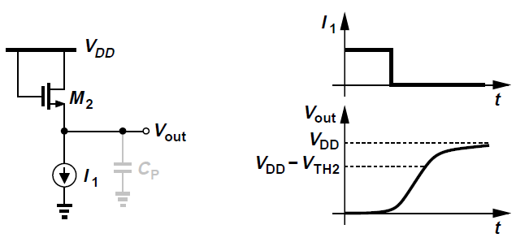


CS Stage with Diode-Connected Load
As I₁ falls, so does overdrive of M₂ so that
Subthreshold conduction of M₂ eventually brings V_{out} to V_{DD}, but at very low current levels, finite capacitance at output node C_{P} slows down the change in V_{out} from V_{DD}-V_{TH2} to V_{DD}.
In high-frequency circuits, V_{out} remains around V_{DD}-V_{TH2} when I₁ falls to small values.

Slide 14
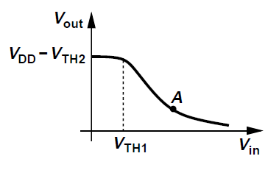
CS Stage with Diode-Connected Load
For V_{in} < V_{TH1}, V_{out} = V_{DD} – V_{TH2}
When V_{in} > V_{TH1}, previous large-signal analysis predicts that V_{out} approximately follows a single line
As V_{in} exceeds V_{out} + V_{TH1} (to the right of point A), M₁ enters the triode region and the characteristic becomes nonlinear.

Slide 15
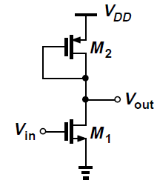


CS Stage with Diode-Connected PMOS device
Diode-connected load can be implemented as a PMOS device, free of body-effect
Small-signal voltage gain neglecting channel-length modulation
Gain is a relatively weak function of device dimensions
Since µ_{n} ≈ 2µ_{p}, high gain requires “strong” input device (narrow) and “weak” load device (wide)
This limits voltage swings since for λ = 0, we get
For diode-connected loads, swing is constrained by both required overdrive voltage and threshold voltage, i.e., for small overdrive, output cannot exceed V_{DD} - |V_{TH}|.

Slide 16
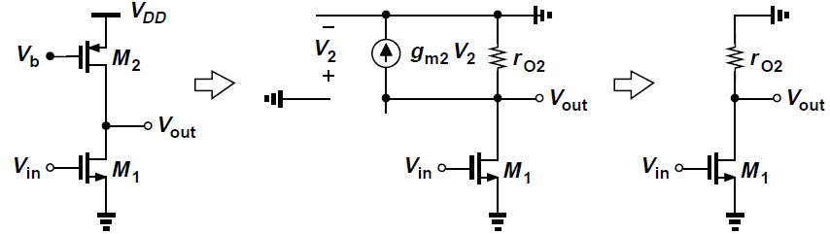


CS Stage with Current-Source Load
Current-source load allows a high load resistance without limiting output swing
Voltage gain is
Overdrive of M₂ can be reduced by increasing its width, r_{o2} can be increased by increasing its length
Output bias voltage is not well-defined
Intrinsic gain of M₁ increases with L and decreases with I_{D}

Slide 17
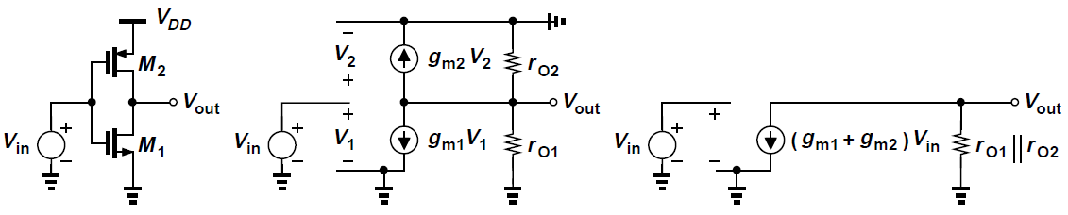


CS Stage with Active Load
Input signal is also applied to gate of load device, making it an “active” load
M₁ and M₂ operate in parallel and enhance the voltage gain
From small-signal equivalent circuit,
Same output resistance as CS stage with current-source load, but higher transconductance
Bias current of M₁ and M₂ is a strong function of PVT

Slide 18
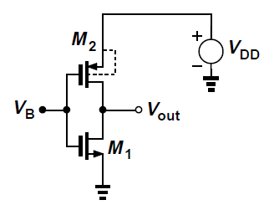

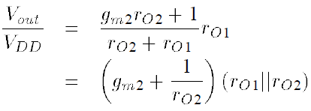
CS Stage with Active Load: Supply sensitivity
Variations in V_{DD} or the threshold voltages directly translate to changes in the drain currents
Supply voltage variations “supply noise” are amplified too
Voltage gain from V_{DD} to V_{out} can be found to be

Slide 19
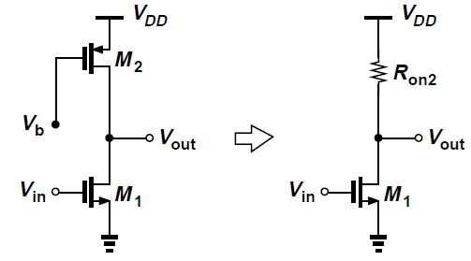

CS Stage with Triode Load
A MOS device biased in the deep triode region acts as a resistive load in a CS stage
V_{b} is sufficiently low to ensure M₂ is in deep triode region for all output voltage swings
Voltage gain is A_{v} = -g_{m1}R_{on2}, where R_{on2} is the MOS ON resistance given by
R_{on2} depends on µ_{p}C_{ox}, V_{b} and V_{THP} which vary with PVT
Generating a precise value of V_{b} is complex, which makes circuit hard to use
Triode loads consume lesser voltage headroom than diode-connected devices since V_{out,max} = V_{DD} for the former whereas V_{out,max} = V_{DD}-|V_{THP}| for the latter

Slide 20
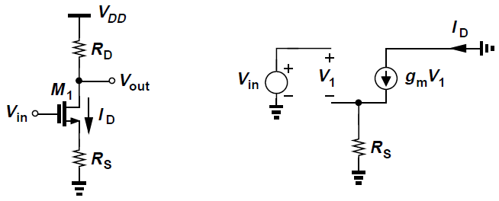
CS Stage with Source Degeneration
Degeneration resistor R_{S} in series with source terminal makes input device more linear
  As V_{in} increases, so do I_{D} and the voltage drop across R_{S}
  Part of the change in V_{in} appears across R_{S} rather than gate-source overdrive, making variation in I_{D} smoother
Gain is now a weaker function of g_{m}

Slide 21



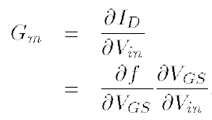

CS Stage with Source Degeneration
Nonlinearity of circuit is due to nonlinear dependence of I_{D} upon V_{in}
Equivalent transconductance G_{m} of the circuit can be defied as

Slide 22



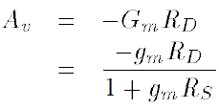
CS Stage with Source Degeneration
g_{m} is the transconductance of M₁
Small-signal voltage gain A_{v} is then given by

Slide 23




CS Stage with Source Degeneration
Same result for G_{m} is obtained from small-signal equivalent circuit, by noting that
As R_{S} increases, G_{m} becomes a weaker function of g_{m} and hence I_{D}
For , , i.e.,
Most of the change in V_{in} across R_{S} and drain current becomes a “linearized” function of input voltage

Slide 24
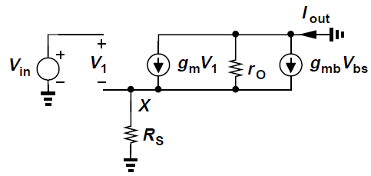

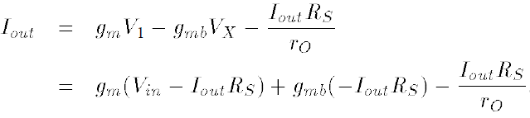
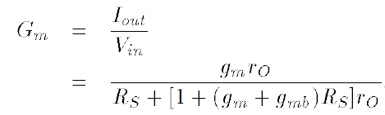
CS Stage with Source Degeneration
Including body-effect and channel-length modulation, G_{m} is found from modified small-signal equivalent circuit

Slide 25
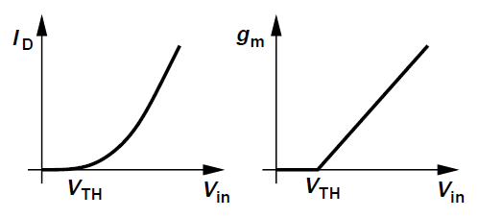
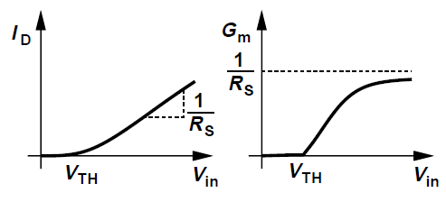


CS Stage with Source Degeneration
Large-signal behavior
R_{S}=0
R_{S}≠0
I_{D} and g_{m} vary with V_{in} as derived in calculations in Chapter 2
At low current levels, turn-on behavior is similar to when R_{S}=0 since and hence
As overdrive and g_{m} increase, effect of R_{S} becomes more significant

Slide 26
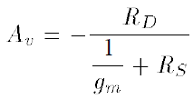
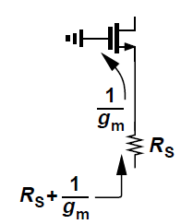
CS Stage with Source Degeneration
Small-signal derived previously can be written as
Denominator = Series combination of inverse transconductance + explicit resistance seen from source to ground
Called “resistance seen in the source path”
Magnitude of gain = Resistance seen at the drain/ Total resistance seen in the source path

Slide 27
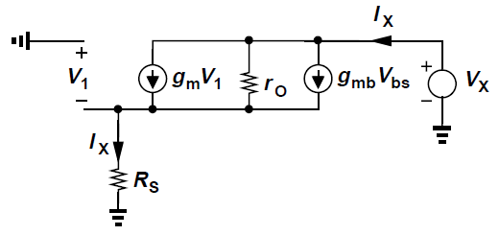


CS Stage with Source Degeneration
Degeneration causes increase in output resistance
Ignoring R_{D} and including body effect in small-signal equivalent model,
r_{o} is boosted by a factor of {1 + (g_{m}+g_{mb})R_{S}} and then added to R_{S}
Alternatively, R_{S} is boosted by a factor of {1 + (g_{m}+g_{mb})r_{o}} and then added to r_{o}
Current through ro

Slide 28

CS Stage with Source Degeneration
Compare R_{S} = 0 with R_{S} > 0
If R_{S} = 0, and
If R_{S} > 0, and , obtaining negative g_{m}V₁ and g_{mb}V_{bs}
Thus, current supplied by V_{X} is less than V_{X}/r_{o} and hence output impedance is greater than r_{o}

Slide 29
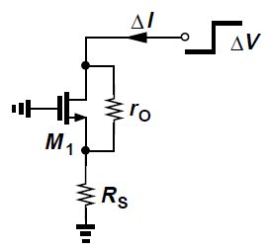
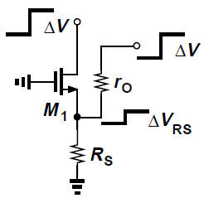
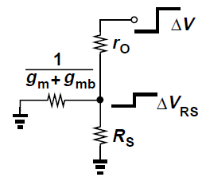
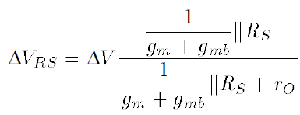
CS Stage with Source Degeneration
Intuitive understanding of increased output impedance
Apply voltage change ΔV at output and measure resulting change ΔI in output current, which is also the change in current through R_{S}
Resistance seen looking into the source of M₁ is 1/(g_{m} + g_{mb})
Voltage change across R_{S} is

Slide 30
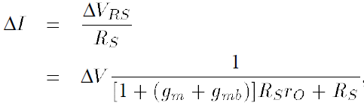

CS Stage with Source Degeneration
Intuitive understanding of increased output impedance
Change in current across R_{S} is
Output resistance is thus

Slide 31
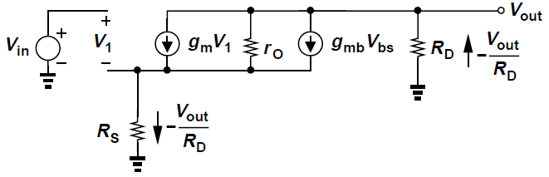

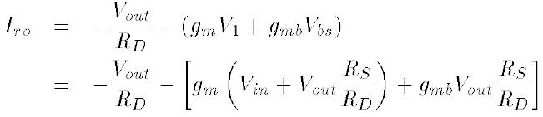
CS Stage with Source Degeneration
To compute gain in the general case including body effect and channel-length modulation, consider above small-signal model
From KVL at input,
KCL at output gives

Slide 32
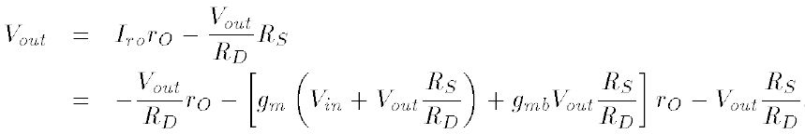

CS Stage with Source Degeneration
Since voltage drops across r_{O} and R_{S} must add up to V_{out},
Voltage gain is therefore

Slide 33
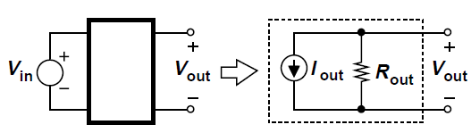
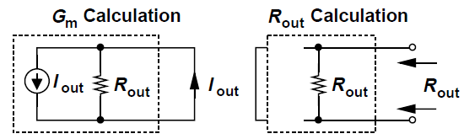
Lemma
In a linear circuit, the voltage gain is equal to –G_{m}R_{out}
  G_{m} denotes the transconductance of the circuit when output is shorted to ground
  R_{out} represents the output resistance of the circuit when the input voltage is set to zero
Norton equivalent of a linear circuit

Slide 34
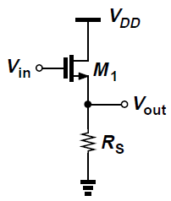
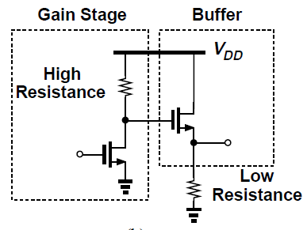
Source Follower
Source follower (also called “common-drain” stage) senses the input at the gate and drives load at the source
It presents a high input impedance, allowing source potential to “follow” the gate voltage
Acts as a voltage buffer

Slide 35
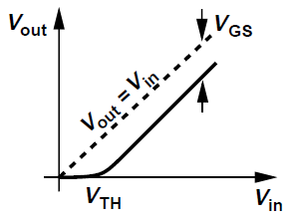

Source Follower
For V_{in} < V_{TH}, M₁ is off and V_{out} = 0
As V_{in} exceeds V_{TH}, M₁ turns on in saturation since V_{DS} = V_{DD} and V_{GS} –V_{TH} ≈ 0 and I_{D1} flows through R_{S}
As V_{in} increases further, V_{out} follows the input with a difference (level shift) equal to V_{GS}
Input-output characteristic neglecting channel-length modulation can be expressed as

Slide 36
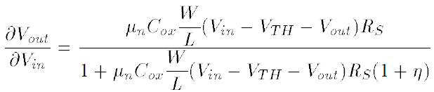


Source Follower
For V_{in} < V_{TH}, M₁ is off and V_{out} = 0
Differentiating both sides of large-signal equation for V_{out},
Since ,
Therefore,
Note that
Therefore,

Slide 37
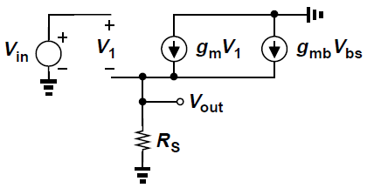


Source Follower
Small-signal gain can be obtained more easily using small-signal equivalent model
We have,
KVL:
KCL:
Therefore,

Slide 38
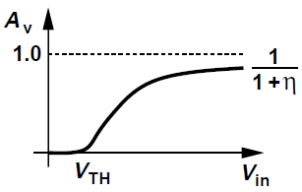

Source Follower
Voltage gain begins from zero for V_{in} ≈ V_{TH} (g_{m} ≈ 0), and monotonically increases
As drain current and g_{m} increase, A_{v} approaches
Since η itself slowly decreases with V_{out}, A_{v} would eventually become equal to unity, but for typical allowable source-bulk voltages, η remains greater than roughly 0.2
Even if R_{S} = ∞, voltage gain of a source follower is not equal to one

Slide 39

Source Follower
Drain current of M₁ depends heavily of input dc level
Even if V_{TH} is relatively constant, the increase in V_{GS} means that V_{out} (=V_{in}-V_{GS}) does not follow V_{in} faithfully, incurring nonlinearity
To alleviate this issue, the resistor can be replaced by a constant current source
Current source is itself is implemented as an NMOS transistor operating in the saturation region

Slide 40



Source Follower
Calculation of output impedance
From small-signal equivalent circuit,
It follows that and
Body effect decreases output resistance of source followers
If V_{X} decreases by ΔV so the drain current increases
  w/o body effect, V_{GS} increases by ΔV
  with body effect, V_{TH} decreases as well, thus (V_{GS}-V_{TH})² and I_{D1} increase by a greater amount, hence lower output impedance

Slide 41


Source Follower
Magnitude of the current source g_{mb}V_{bs} = g_{mb}V_{X} is linearly proportional to the voltage across it, can be modelled by a resistor equal to 1/g_{mb} (valid only for source followers)
This appears in parallel with the output, decreasing the overall output resistance
Since without 1/g_{mb}, the output resistance is 1/g_{m}, we conclude that

Slide 42


Source Follower
Modelling effect of g_{mb} by a resistor helps explain lower than unity gain for R_{S} = ∞
From the Thevenin equivalent circuit

Slide 43



Source Follower
Small-signal equivalent circuit with a finite load resistance and channel-length modulation is shown
1/g_{mb}, r_{O1}, r_{O2} and R_{L} are in parallel, therefore,
It follows that

Slide 44
Issues with Source Follower
Source followers exhibit high input impedance and moderate output impedance, but at the cost of
  Nonlinearity
  Voltage headroom limitation
Even when biased by ideal current source, there is input-output nonlinearity due to nonlinear dependence of V_{TH} on the source potential
In submicron technologies, r_{O} changes substantially with V_{DS} and introduces additional variation in small-signal gain

Slide 45

Issues with Source Follower
Nonlinearity can be eliminated if the bulk is tied to the source
  Possible only for PFETs since all NFETs usually share the same substrate
PMOS source follower employing two separate n-wells can eliminate the body effect of M₁
Lower mobility of PFETs yields a higher output impedance than that available in the NMOS counterpart

Slide 46

Issues with Source Follower
Source followers also shift the dc level of the signal by V_{GS}, thereby consuming voltage headroom
In the cascade of CS stage and source follower shown above,
  w/o source follower, minimum allowable value of V_{X} would be V_{GS1}-V_{TH1} (for M₁ to remain in saturation)
  with source follower, V_{X} must be greater than V_{GS2}+(V_{GS3}-V_{TH3}) so that M₃ is saturated
For comparable overdrive voltages in M₁ and M₃, allowable swing at X is reduced by V_{GS2}

Slide 47


Comparison of CS stage and Source Follower
Comparing the gain of source followers and CS stage with a low load impedance
  E.g., driving an external 50-Ω termination in a high-frequency environment
When load is driven by a source follower, overall voltage gain is

Slide 48

Comparison of CS stage and Source Follower
Load can be included as part of a common-source stage, providing a gain of
Key difference between the two topologies is the achievable voltage gain for a given bias current
For example, if , source follower exhibits a gain of at most 0.5 whereas the common-source stage provides a gain close to unity
Thus, source followers are not efficient drivers

Slide 49

Common-Gate Stage
A common-gate (CG) stage senses the input at the source and produces the output at the drain
Gate is biased to establish proper operating conditions
Bias current of M₁ flows through the input signal source
Alternatively, M₁ can be biased by a constant current source, with the signal capacitively coupled to the circuit

Slide 50




Common-Gate Stage: Large-signal behavior
Assume V_{in} decreases from a large positive value and that λ=0
For V_{in} ≥ V_{b}-V_{TH}, M₁ is off and V_{out} = V_{DD}
For lower values of V_{in}, if M₁ is in saturation,
As V_{in} decreases further, so does V_{out} driving M₁ into the triode region if
In the region where M₁ is saturated, we can express the output voltage as

Slide 51




Common-Gate Stage
Input-output characteristic
For M₁ in saturation,
Small-signal gain can thus be obtained
Since , we have

Slide 52
Common-Gate Stage
Gain of the common-gate (CG) stage is positive
Body effect increases the effective transconductance of the stage
For a given bias current and supply voltage (i.e., a given power budget), voltage gain of the CG stage can be maximized by
  Increasing gm by widening the input device, eventually reaching subthreshold operation [g_{m}=I_{D}/ζV_{T}]
  Increasing R_{D} and inevitably, the dc drop across it
The minimum allowable value of V_{out} is V_{GS}-V_{TH}+V_{I1}, where V_{I1} denotes the minimum voltage required by I₁

Slide 53




Common-Gate Stage
Consider output impedance of transistor and impedance of the signal source
In small-signal equivalent circuit, since current flowing R_{S} is –V_{out}/R_{D},
(1)
Moreover, since current through r_{O} is
(2)

Slide 54


Common-Gate Stage
Common-Gate Stage
Substituting V₁ from (1) in (2),
Therefore,
The voltage gain expression is similar to that of a degenerated CS stage

Slide 55


Common-Gate Stage: Input Impedance
From the small-signal equivalent circuit for finding input impedance, we have
The current through r_{O} is equal to I_{X} + g_{m}V₁ + g_{mb}V₁ = I_{X} - (g_{m}+g_{mb})V_{X}
Voltages across r_{O} and R_{D} can be added and equated to

Slide 56

Common-Gate Stage: Input Impedance
Thus,
If (g_{m} + g_{mb})r_{O} >> 1
The drain impedance is divided by (g_{m} + g_{mb})r_{O} when seen at the source
  Important in short-channel devices because of their low intrinsic gain

Slide 57

Common-Gate Stage: Input Impedance
Suppose R_{D} = 0, then
This is the impedance seen at the source of a source follower, a predictable result since with R_{D} = 0 the circuit configuration is the same as a source follower

Slide 58

Common-Gate Stage: Input Impedance
If R_{D} is replaced with an ideal current source, earlier result predicts that input impedance approaches infinity
Total current through the transistor is fixed and is equal to I₁
Therefore, a change in the source potential cannot change the device current, and hence I_{X} = 0
The input impedance of a CG stage is relatively low only if the load impedance connected to the drain is small

Slide 59


Common-Gate Stage
In a CG stage with a current source load, substituting R_{D}=∞ in the voltage gain equation, we get
Gain does not depend on R_{S}
From the foregoing discussion, if R_{D}→∞, so does the impedance seen at the source of M₁, and the small-signal voltage at node X becomes equal to V_{in}

Slide 60

Common-Gate Stage
In a degenerated CS stage, we loosely say that a transistor transforms its source resistance up
In a CG stage, the transistor transforms its drain resistance down
The MOS transistor can thus be viewed as a impedance (resistance) transformer

Slide 61

Common-Gate Stage: Output Impedance
From the above small-signal equivalent circuit, we can find output impedance as
Result is similar to that obtained for a degenerated CS stage

Slide 62


Common-Gate Stage
Input signal of a common-gate stage may be a current rather than a voltage as shown below
Input current source exhibits output impedance of R_{P}
To find the “gain” V_{out}/I_{in}, replace I_{in} and R_{P} with a Thevenin equivalent and use derived result to write
Output impedance is simply given by

Slide 63

Cascode Stage
The cascade of a CS stage and a CG stage is called a cascode topology
M₁ generates a small-signal drain current proportional to the small-signal input V_{in} and M₂ simply routes the current to R_{D}
M₁ is called the input device and M₂ the cascode device
M₁ and M₂ in this example carry equal bias and signal currents
  Topology also called as “telescopic cascode”

Slide 64

Cascode Stage: Qualitative Analysis
Assume both transistors are in saturation and λ = γ = 0
If V_{in} rises by ΔV, then I_{D1} increases by g_{m1}ΔV
This change in current flows through the impedance seen at X, i.e., the impedance seen at the source of M₂, which is equal to 1/g_{m2}
Thus, V_{X} falls by an amount given by g_{m1}ΔV∙(1/g_{m2})
This change in I_{D1} also flows through R_{D}, producing a drop of g_{m1}ΔVR_{D} in V_{out}, just as in a simple CS stage

Slide 65

Cascode Stage: Qualitative Analysis
Consider the case when V_{in} is fixed and V_{b} increases by ΔV
Since V_{GS1} is constant and r_{O1}=∞, M₁ can be replaced by an ideal current source
For node X, M₂ operates as a source follower, it senses an input ΔV at its gate and generates an output at X
With λ = γ = 0, the small-signal voltage of the follower is unity regardless of R_{D}
V_{X} rises by ΔV, but V_{out} does not change since I_{D2}=I_{D1}=constant, thus voltage gain from V_{b} to V_{out} is zero

Slide 66





Cascode Stage: Bias Conditions
For M₁ to operate in saturation, we must have
If M₁ and M₂ are both in saturation, M₂ operates as a source follower and V_{X} is primarily determined by V_{b}:
Thus, and hence
For M₂ to be saturated,
Thus,
if V_{b} is chosen to place M₁ at the edge of saturation
Minimum output level for which both transistors are in saturation is equal to the sum of overdrives of M₁ and M₂
Addition of M₂ to the circuit reduces the output voltage swing by at least its overdrive voltage

Slide 67

Cascode Stage: Large-Signal Behavior
For V_{in}≤V_{TH1}, M₁ and M₂ are off, V_{out}=V_{DD}, and V_{X}≈V_{b}-V_{TH2}
As V_{in} exceeds V_{TH1}, M₁ draws current, and V_{out} drops
Since I_{D2} increases, V_{GS2} must increase as well, causing V_{X} to fall
As V_{in} becomes sufficiently large, two effects can occur:
  V_{X} falls below V_{in} by V_{TH1}, forcing M₁ into the triode region
  V_{out} drops below V_{b} by V_{TH2}, driving M₂ into triode region
Depending on device dimensions and R_{D} and V_{b}, one effect may occur before the other

Slide 68

Cascode Stage: Small-signal characteristics
Assume both transistors operate in saturation and λ=0
Voltage gain is equal to that of a common-source stage because the drain current produced by the input device must flow through the cascode device
This result is independent of the transconductance and body effect of M₂, the cascode device
Can be verified using A_{v} = -G_{m}R_{out}

Slide 69


Cascode Stage: Output Impedance
Important property of the cascode structure is its high output impedance
For calculation of R_{out}, the circuit can be viewed as a common-source stage with a degeneration resistor equal to r_{O1}
Thus,
Assuming g_{m}r_{O}>>1, we have
M2 boosts the output impedance of M1 by a factor of (g_{m2}+g_{mb2})r_{O2}

Slide 70

Triple Cascode
Cascoding can be extended to three or more stacked devices to achieve higher output impedance
But required additional voltage headroom makes it less attractive
For a triple cascode, the minimum output voltage is equal to the sum of three overdrive voltages

Slide 71




Cascode stage with current source load
Voltage gain can be maximized by maximizing G_{m} and/or R_{out}
Since G_{m} is typically determined by the transconductance of a transistor and has trade-offs with the bias current and device capacitances, it is desirable to increase voltage gain by maximizing R_{out}
If both M₁ and M₂ operate in saturation, and yeilwddddddddddddd yielding
Maximum gain is roughly equal to the square of the intrinsic gain of the transistors

Slide 72

Cascode Stage vs Increasing Length
Increasing length of the input transistor for a given bias current increases the output impedance
Suppose the length of the input transistor is quadrupled while the width remains constant
Since , the overdrive voltage is doubled and the transistor consumes the same amount of voltage headroom as does a cascode stage, i.e., circuits in (b) and (c) impose equal voltage swing constraints

Slide 73


Cascode Stage vs Increasing Length
Since
And , quadrupling L only doubles the value of g_{m}r_{O} while cascoding results in an output impedance of roughly g_{m}r_{O}²
Transconductance of M₁ in (b) is only half of that in (c), degrading the performance
For a given voltage headroom, the cascode structure provides a higher output impedance

Slide 74


Cascode Structure as Current Source
High output impedance of cascode structure yields a current source closer to the ideal, but at the cost of voltage headroom
The current source load in a cascode stage can be implemented as a PMOS cascode, exhibiting an impedance equal to
To find the voltage gain, G_{m}≈g_{m1}
Rout is the parallel combination of the NMOS and PMOS cascode output impedances
The gain is given by
For typical values, this is approximated as

Slide 75

Poor Man’s Cascode
A “minimalist” cascode current source omits the bias voltage necessary for the cascode device
Called “poor man’s cascode”, M₂ is placed in the triode region because V_{GS1}>V_{TH1} and V_{DS2}=V_{GS2}-V_{GS1} < V_{GS2}-V_{TH2}
If M₁ and M₂ have the same dimensions, the structure is equivalent to a single transistor having twice the length-not really a cascode
In modern CMOS technologies, transistors with different threshold voltages are allowable, allowing M₂ to operate in saturation if M₁ has a lower threshold than M₂

Slide 76

Poor Man’s Cascode: Shielding Property
High output impedance arises from the fact that if the output node voltage is changed by ΔV, the resulting change at the source of the cascode device is much less
  Cascode transistor “shields” the input device from voltage variations at the output
Shielding property diminishes if cascode device enters triode region
In above circuit, as V_{X} falls below V_{b2}-V_{TH2}, M₂ enters triode region and requires a greater gate-source overdrive to sustain the current drawn by M_{1,} therefore
As V_{X} decreases, V_{P} also drops to keep I_{D2} constant so variation of V_{X} is less attenuated as it appears at P

Slide 77

Folded Cascode
The input device and the cascode device in a cascode structure need not be of the same type
In the figure above, (a) shows a PMOS-NMOS cascode combination that performs the same function as a telescopic cascode
In order to bias M₁ and M₂, a current source must be added as shown in (b)
|I_{D1}| + I_{D2} is equal to I₁ and hence constant
(c) shows an NMOS-PMOS folded cascode

Slide 78
Folded Cascode: Small-signal operation
If V_{in} becomes more positive, |I_{D1}| decreases, forcing I_{D2} to increase and hence V_{out} to drop
The voltage gain and output impedance can be obtained as calculated for the NMOS-NMOS cascode shown earlier
(b) and (c) are called “folded cascode” stages because the small-signal current is “folded” up [in (b)] or down [in (c)]
In the telescopic cascode, the bias current is reused whereas those of M₁ and M₂ add up to I₁ in (b) and (c), leading to a higher bias current

Slide 79


Folded Cascode: Large-signal operation
Suppose V_{in} decreases from V_{DD} to zero
For V_{in} > V_{DD}-|V_{TH1}|, M₁ is off and M₂ carries all of I₁, yielding V_{out} = V_{DD} - I₁R_{D}
For V_{in} < V_{DD} - |V_{TH1}|, M₁ turns on in saturation, giving
As V_{in} drops, I_{D2} decreases further, falling to zero if I_{D1}=I₁

Slide 80



Folded Cascode: Large-signal operation
This occurs at V_{in} = V_{in1} if
Thus,
If V_{in} falls below this level, I_{D1} tends to be greater than I₁ and M₁ enters the triode region to ensure I_{D1}=I₁
As I_{D2} drops, V_{X} rises, reaching V_{b}-V_{TH2} for I_{D2}=0
As M₁ enters the triode region, V_{X} approaches V_{DD}

Slide 81


Folded Cascode: Output Impedance
M₃ operates as the bias current source
Using earlier results,
The circuit exhibits a lower output impedance than a nonfolded (telescopic) cascode

Slide 82

Folded Cascode with cascode load
To achieve a high voltage gain, the load of a folded cascode can be implemented as a cascode itself
Increasing the output resistance of voltage amplifiers to obtain a high gain may make the speed of the circuit susceptible to the load capacitance
A high output impedance itself does not pose a serious issue if the amplifier is placed in a proper feedback loop

